Slide 1
COSC 151: Intro to Programming: C++
Introduction &
Chapter 1

Slide 2
Overview
Syllabus
  Homework is important, keep up with it
  Attendance is mandatory
    You won't keep up otherwise
  Quizzes
    Will use these from time to time to judge your progress
  Final (Capstone) Project
    Will be a large project of code you write

Slide 3
Why Programming???
Software Engineering
  One of the fastest growing fields
  Consistently high ranks in pay, job satisfaction
Computers are everywhere!
  Every business uses computers at some level
  Desktop PCs, phones, watches, gaming systems, embedded devices (Nest, etc.)

Slide 4
Making Your Life Easier
Important concepts are in RED.
Code/Commands are fixed font and purple
When discussing C++
  Normal code is fixed width, dark gray
  Keywords are fixed width, blue
  Comments are fixed width, green
stackoverflow.com
  Don't be afraid to ask questions

Slide 5
Making You Life Easier, contd
In your code, use consistent indentation!
        int main() { std::cout << “Hello, World”
        << std::endl; return
        0; }
    Is significantly harder to read than (they have the same meening!!!!!)
        int main()
        {
        std::cout << “Hello, World” << std::endl;
        return 0;
        }
In your code, use braces around conditional and iteration statements, even if they aren't technically required!
        if(x == 0)
        print_stuff();
    While legal (and correct), prefer (it's easier to follow and understand!!!)
        if(x == 0)
        {
        print_stuff();
        }

Slide 6
Chapter 1: Getting Started
Objectives
  We should be able to
    Define variables
    Perform input and output
    Use control blocks
      Conditionals
      Iteration
    Use a data structure to hold program data

Slide 7
C1: Writing a Simple Program
All C++ programs are made up of one or more functions, one of which must be called “main”
    int main()
    {
    return 0;
    }
Function definitions have 4 elements
  Return type (in this case int)
  Function name (in this case main)
  A (possibly empty) parameter list (in this case ())
  A function body (in this case the lines including the braces)

Slide 8
C1: Input and Output
Input and output typically done through streams
Streams provided as part of the standard library, our examples use iostream
Input is done through an input stream (istream)
Output is done through an output stream (ostream)

Slide 9
C1: Input and Output - contd
Standard IO Objects
  There are four standard IO objects we can use in our programs
    std::cout – standard output
    std::cin – standard input
    std::cerr – standard error
    std::clog – standard log
    By default, these all print to the same output window

Slide 10
C1: Using the Standard Library
Whenever we use a type or object from the standard library, we prefix it's usage with std::.
  This tells the compiler to use the type or object as defined in the std namespace.
  Namespaces allow us to use names we define without colliding with other potential uses of those same names.
  We will learn more about namespaces in the coming weeks.

Slide 11
C1: Writing to a Stream
We write to a stream using the “stream insertion operator” (operator<<)
    std::cout << “Hello, World!” << std::endl;
Calls to the stream insertion operator can “chain” making the above possible, similar to this:
    std::cout << “Hello, World!”;
    std::cout << std::endl;
Output statements can be very helpful for debugging your programs

Slide 12
C1: Reading from a Stream
We read from a stream using the “stream extraction operator” (operator>>)
    int x = 0, y = 0;
    std::cin >> x >> y;
Calls to the stream extraction operator can “chain” making the above possible, similar to this:
    int x = 0, y = 0;
    std::cin >> x;
    std::cin >> y;

Slide 13
C1: Comments
Comments allow us to add information to our source code that isn't read by the compiler
  Line Comments, all text from // to the end of line are ignored.
  Comment pairs, all text between /* and */ are ignored.
    Comment pairs do not nest!

Slide 14
C1: Include Directives
When we want to use code that isn't defined locally in our source file, we need to tell the compiler that we want to use it.
We do that with an “include directive”.
An include directive tells the compiler to find the requested file and make the declarations and definitions in that file available to our local source file.
Example:
  #include <iostream>
    This tells the compiler to find the iostream header file and make the “stuff” in that file available for use.

Slide 15
C1: A Program using IO Streams
#include <iostream> // Necessary to use the IO stream library
int main()
{
// Use the standard output stream to prompt the user.
std::cout << “Enter two numbers: “ << std::endl;
// Define two int variables, and read them in
// using the standard input stream
int v1 = 0, v2 = 0;
std::cin >>v1 >> v2;
// print the output
std::cout << “The sum of “ << v1 << “ and “ << v2
<< “ is “ << v1 + v2 << std::endl;
return 0;
}

Slide 16
C1: Flow of Control
Almost all programs require us to control logic flow, the basic patterns available are
  Iteration – iterate over a range of values and take action
  Conditional – determine an appropriate course of action at runtime based on inputs or program state

Slide 17
C1: Flow of Control: Iteration (while)
A while statement (or while loop) executes a section of code as long as a given condition is true.
Looping from 1 to 10:
    int sum = 0, val = 1;
    while(val <= 10) // keeps executing until val > 10
    {
    sum += val; // equivalent to sum = sum + value;
    ++val; // equivalent to val = val + 1;
    }

Slide 18
C1: Flow of Control: Iteration (for)
A for statement (or for loop) executes a section of code as long as a given condition is true.
A for statement captures the control variables at the top, where it's less likely they will be missed.
Looping from 1 to 10:
    int sum = 0; // no need to define val here
    // sum defined here because it needs to be used
    // outside of the for statement's scope
    // val is defined, the condition is checked, and val incremented
    // all within the top of the for statement
    for(int val = 1; val <= 10; ++val)
    {
    sum += val; // equivalent to sum = sum + val;
    }

Slide 19
C1: Flow of Control: Conditional (if)
The if statement supports conditional execution.
An if statement can be standalone
    if(grade > 70)
    {
    std::cout << “You're passing.” << std::endl;
    }
Or it can have an else condition
    if(grade > 70)
    {
    std::cout << “You're passing.” << std::endl;
    }
    else
    {
    std::cout << “Oh, no!” << std::endl;
    }
Or it can have (one or more) else if conditions
    if(grade > 98)
    {
    std::cout << “Wow, A+” << std::endl;
    }
    else if(grade > 93)
    {
    std::cout << “Excellent, A” << std::endl;
    }
    else if(grade > 90)
    {
    std::cout << “Alright, A-” << std::endl;
    }
    else
    {
    std::cout << “Not, an A :(“ << std::endl;
    }

Slide 20
C1: Assignment vs. Equality
C++ (and a significant number of other modern language) differentiate between assignment (operator=) and equality (operator==).
  This can be confusing, especially since there are places where assignment is allowed, but typically not expected (by the programmer). A common source of errors:
      int x = 10;
      if(x = 20) // Assigns x the value of 20!
      {
      std::cout << “x is 20!” << std::endl; // Will print!
      }
      if(x == 10) // Compares x to 10, but x is 20 (from above)
      {
      std::cout << “x is 10!” << std::endl; // Will not print!!
      }

Slide 21
C1: Reading multiple Inputs
The input stream supports an implicit conversion that allows it to be checked for validity
We can use this to read in an unknown number of inputs
    int sum = 0, val = 0;
    while(std::cin >> val) // keep reading until end-of-file, or failure
    {
    sum += value;
    }
On Linux (your koding.com virtual machine), you stop entering inputs using <CTRL> + d

Slide 22
C1: Introducing Classes
C++ (like most modern languages) allows users to create their own data types
  The goal is to define class types that behave as naturally as the built-in types.
A class defines a type along with a collection of data values and operations that are related to that type.
The data values are specific to an instance of the class. There will be distinct copies of the data members for each class instance defined.

Slide 23
C1: Classes Define Behavior
A Class defines what operations are allowed and what those operations do
For example
  Adding two class objects – is it allowed, what does it mean?
  Subtracting?
  Other operations?
  We will learn more about what operations we can overload in the coming weeks

Slide 24
C1: Reading and Writing Classes
The stream insertion and stream extraction operators can be defined for a class, allowing reading from and writing to a stream.
    Sales_item book; // we define our book item, like any other type
    std::cin >> book; // read it from a stream
    std::cout << book // write it to a stream
    << std::endl;

Slide 25
C1: Adding Classes
The Sales_item class defines the addition operator (operator+) to aggregate its data members
    Sales_item item1, item2;
    std::cin >> item1 >> item2; // read in two books
    std::cout << item1 + item2 // write out their “sum”
    << std::endl;

Slide 26
C1: Class Member Access
You can access the members of a class using the dot operator (“.” operator).
    Sales_item item1;
    std::cin >> item1 >> item2; // read in two books
    if(item1.isbn() == item2.isbn()) // if they have the same ISBN
    {
    std::cout << item1 + item2 // write out their “sum”
    << std::endl;
    }
    else
    {
    std::cout << “Books have different ISBN” << std::endl;
    }
Here we've called a member function named isbn().
  Member functions are sometimes called methods.

Slide 27
Final Thoughts
Setup your environment on koding.com
We have to define variables before we can use them
Print output using std::cout
      Helpful for debugging
Read input using std::cin
Use while or for for iteration
Use if/else if/else for conditional checking
Classes are user defined types that group data and operations

Slide 28
Environment Setup
Register for an account on koding.com
  Once registered and verified, a VM will be created for you on the site, this will be our main environment for development
Install the necessary software
  In the terminal tab, type the following then hit <Enter>
    sudo apt-get install g++
  When prompted to continue, press Y then <Enter>

Slide 29
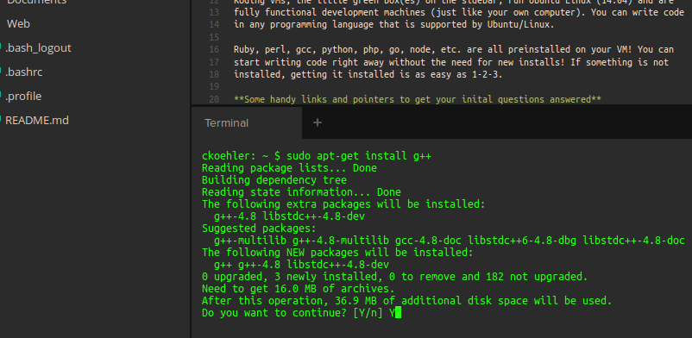
Environment Setup - contd

Slide 30
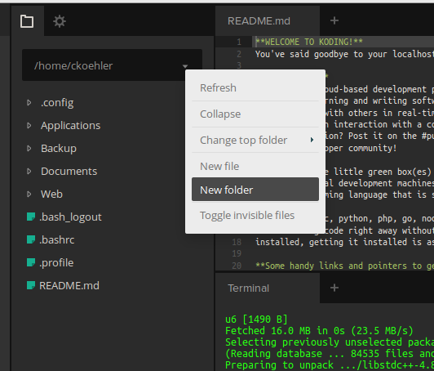
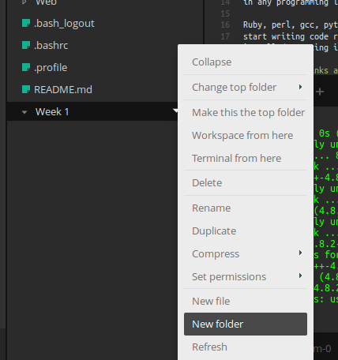
Environment Setup - contd
Create folders for each week, and each assignment:

Slide 31
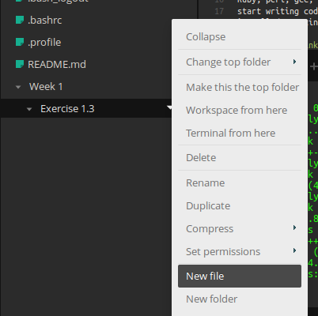
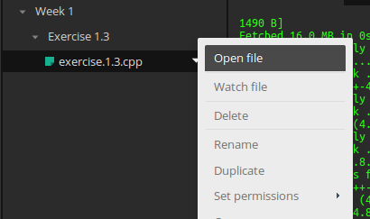
Environment Setup - contd
When working on an assignment, create a file in the assingment's folder
  Name the file exercise.[chapter].[exercise].cpp
  For example: exercise.1.3.cpp.
  Click on “Open File” to begin editing

Slide 32
Environment Setup – contd
Edit your file, hit <CTRL> + S to save.
To build:
  right click the assignment's folder, then select “Terminal from Here.”
    This will open a new terminal tab in your assignments working directory.
  Invoke the Compiler, with the following command:
g++ -std=c++11 <input file(s)> -o exercise.[chapter].[exercise]
compiler C++ standard input file(s) output file name

Slide 33
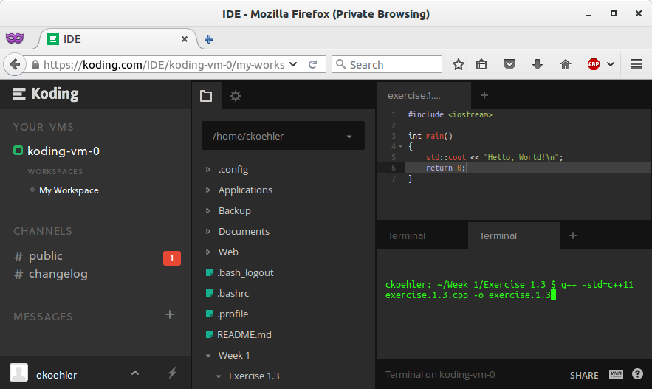
Environment Setup – Full Example

Slide 34
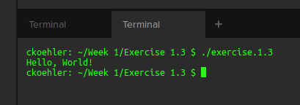
Environment Setup - Running
To run your code, from a terminal in your working directory, type the following:
  ./exercise.[chapter].[exercise]
  Example:

